Slide 1

ORCID AND HRA
What, Why, How?
@ORCID_ORG
05 OCT 2017
ALICE MEADOWS
ERIC OLSON
Community Engagement/Support
Membership Support, United States
http://orcid.org/0000-0003-2161-3781
http://orcid.org/ 0000-0002-5989-8244
Notes:
ORCID overview: why your lifelong identifier is important in the digital age.

Slide 3
Why do funders care?
Streamline application process by pulling information from ORCID
Ensure accurate citation of award (both grant numbers and organization name) by pushing award information into ORCID record
Enable real-time reporting by using ORCID notification API
Recognize your reviewers, too!

Slide 4
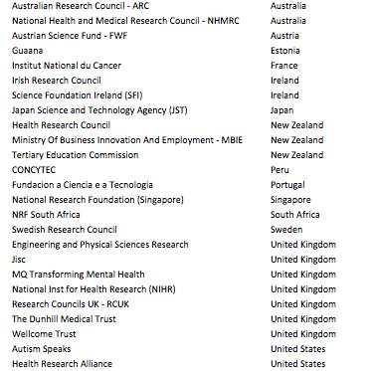
ORCID funder members

Slide 5
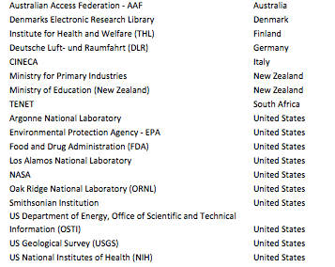
ORCID govt organization members

Slide 6
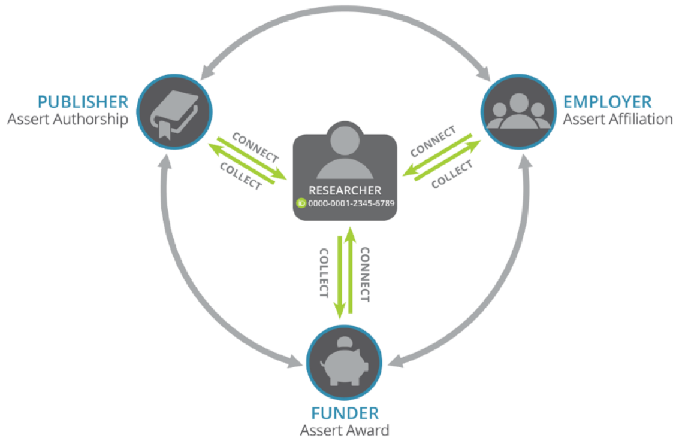

Slide 7
Making our vision a reality: publishing workflows
Researchers can sign into a manuscript submission system using their ORCID credentials
Their iD is automatically included in their article’s metadata
And that information is used to automatically update their ORCID record with the new work
You can access authoritative information about your researchers’ publications – in real time!

Slide 8
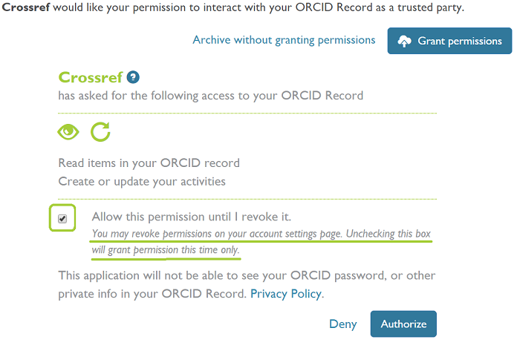
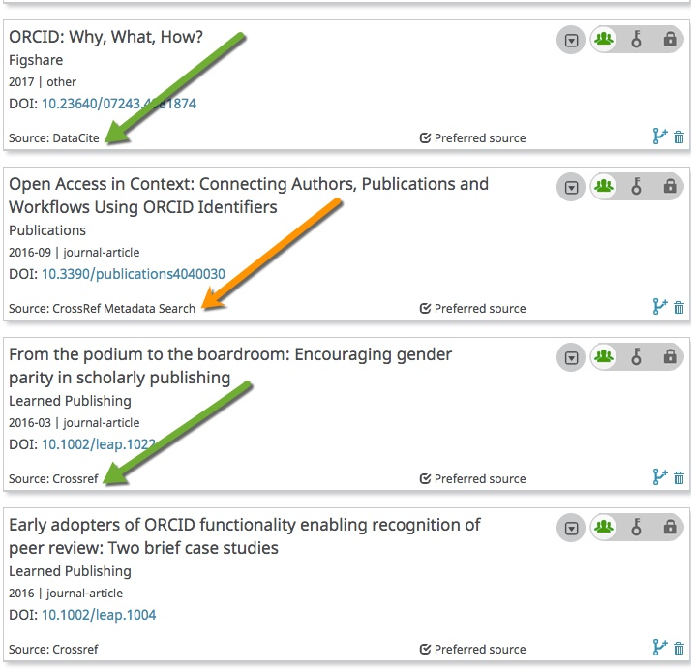
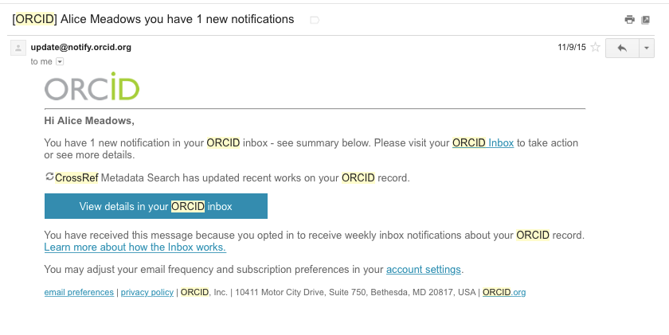
ORCID auto-update

Slide 9
Publishers Open Letter
Commits signatories to:
  Requiring at a minimum corresponding authors to use their ORCID iD in publication process
  Adhering to ORCID best practices for publishers
Signed by 35 publishers globally
25 have now gone live with requirement including:
  AAAS/Science, PLOS, Springer Nature*, Wiley*
  * Selected journals

Slide 10
Making our vision a reality: research institution workflows
Researchers can sign into ORCID using their institutional credentials
Their ORCID iD is connected back to their institution
The institution can assert the researcher’s affiliation with them
You can access authoritative information about their affiliation(s) – and be notified when they change

Slide 11
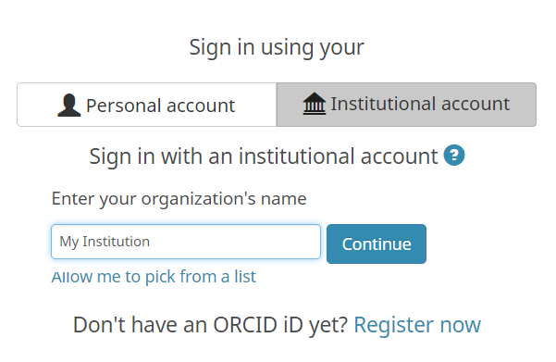
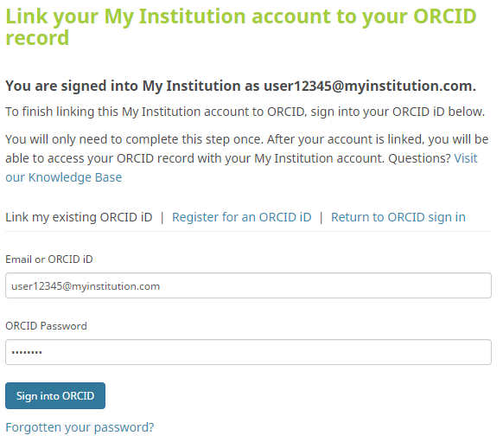
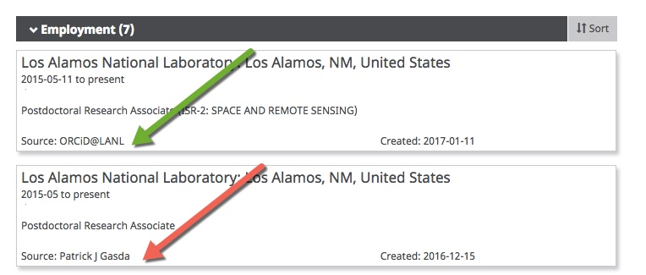
Institutional Connect

Slide 12
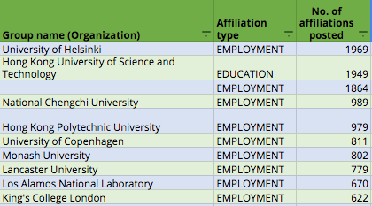
Top 10 affiliation assertions

Slide 13
Making our vision a reality: funder workflows
You can collect information from your researchers’ ORCID records (affiliations, works, etc) to auto-populate your forms
You can connect authoritative information about their awards to their ORCID records so it can be shared with other organizations
You can recognize their review activities for your organization
You can track your researchers throughout their career – automatically using system alerts (web hooks) – making reporting easier

Slide 14
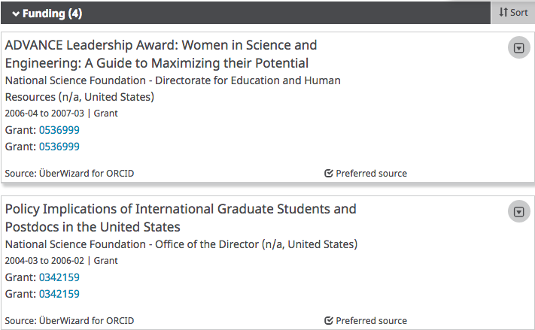

ORCID as facilitator
Building trust:
• Tools to allow for easy addition of identifiers (for people, places, and things) during publishing, grant application, data deposit, etc.
• Engage the community to embed, authenticate, and ASSERT

Slide 15

Grant review workflow
Researcher
Link their ORCID to own account
Funder
Embed reviewer’s ORCID in the review and push review acknowledgement
ORCID
Receive new review info from funder and add to researchers’ ORCID records
Add ORCID to investigators too
Notified via email

Slide 16
A quick walkthrough
The NIH Biosketch integration allows researchers to connect their ID to their SciENcv account, as well as pre-fill some fields, including employment history, education, and works
The NIH grant submission system, eRA Commons will soon follow
https://www.ncbi.nlm.nih.gov/myncbi/

Slide 17




Researcher
ORCID record
Basic information
  Name
  Email addresses etc.
Account settings
Biography, Education, Affiliation
Research activities
  Publication
  Peer review
  Patents
  Grants etc.
xxxx-xxxx-xxxx-xxxx
Register & Manage
ORCID record
Permissions to use
ORCID record
Add & update activities
ORCID member organizations

Slide 18
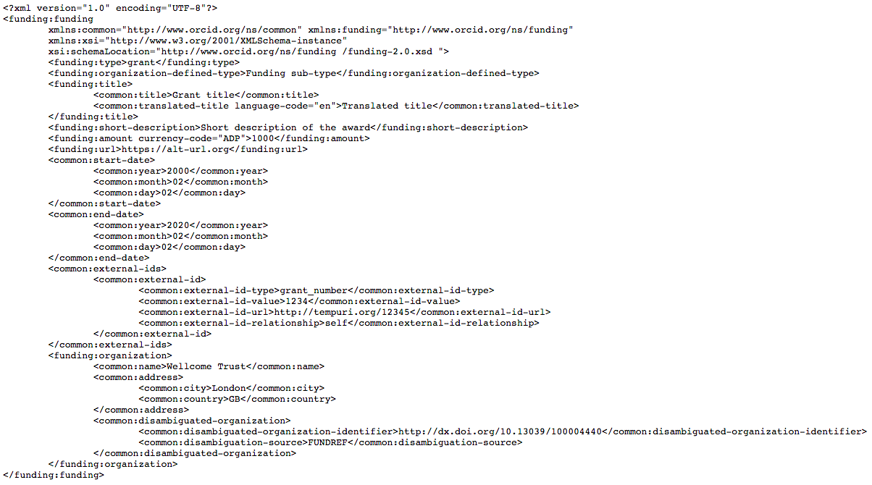
The API call

Slide 19
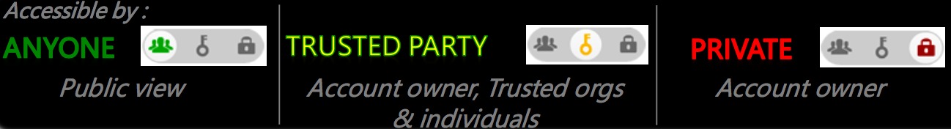
Information in an ORCID Record has a visibility setting, which only the account owner can set – API cannot override.
Account information (settings, permissions) accessible by the account owner.

Slide 20


Benefits of consortium/premium membership
Create up to five ORCID integration points
View limited access data on ORCID records
Connect authoritative information about your researcher’s awards to their ORCID records
Track their progress throughout their career using web hooks
Monitor usage of your integration via monthly custom reports

Slide 21
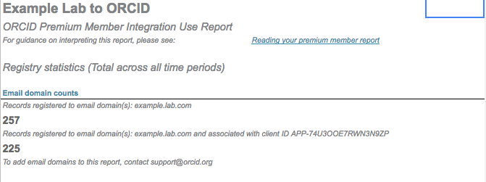
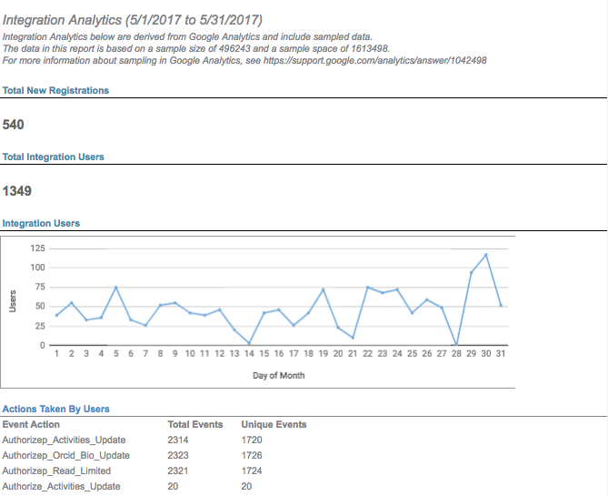
Sample premium report
https://docs.google.com/spreadsheets/d/1QIHxOqjKcjVqcqEmt28kKlGjqzCfU5q3cE_DF3yLK_g/edit#gid=0

Slide 22
ORCID’s responsibilities
Provide technical documentation and best practices
  Collect & Connect program
Review integrations, issue badges, provide credentials
  Sandbox
  Production
Resolve more complex issues
Create and share community resources
Establish communities of practice
  Cross-consortia collaboration
http://ands.org.au/newsletters/share_issue18.pdf

Slide 23
More information
members.orcid.org
  technical documentation, webinar registration, outreach resources
orcid.org
  ORCID blog, information about ORCID, ORCID events
API users group
  informal info and discussion (ORCID tech team)
support@orcid.org
  tier 2 & 3 technical support, sandbox/production credentials, Collect & Connect badges

