Slide 1
Working Groups and Subgroups
  Intellectual Property and Technology Transfer
    Royalty Sharing
    Control of Licensing
    IP Definitional
    Patient Access
  Research Project Support Costs
    Education
    Support Costs
  Streamlining Administrative Requirements
    Application Processes
    Contracting
    Financial Reporting

Slide 2
NFRI UPDATE-
May 22, 2019
Royalty Sharing Subgroup
Subgroup Leads: Jackie Hausman, Kenneth Rainin Foundation; Fred Reinhart, UMass President’s Office; and John Ritter, Princeton

Slide 3
NFRI Royalty Sharing Subgroup
Members: Felice Lu- UCOP; Jilda Garten-GA Tech; Alex Albinak- Johns Hopkins; Jennifer Harris- JHMI; Tom Goodness- Cornell; Jan Thornton- Auburn; Cathy Cottle- U Washington; Dave Winwood- LSU; Rachel Webb- JDRF; Jeremy Nelson- Michigan; Sara Bible- Stanford; Diane Bovenkamp- Brightfocus; Amy Laster- Foundation Fighting Blindness

Slide 4
NFRI Royalty Sharing Subgroup
Progress to date:
Three committee conference calls
Created “Principles & Guidelines for Royalty Sharing”
Assembled sample royalty sharing clauses from NFs and RIs

Slide 5
NFRI Royalty Sharing Subgroup
Principles & Guidelines for Royalty Sharing
Background & History
  Funders have different views re royalty $
  Negotiations can be adversarial and take an inordinate amount of time
  Data show <0.5% of licenses make $1 MM
  Too much effort for very rare outcome

Slide 6
NFRI Royalty Sharing Subgroup
Principles & Guidelines for Royalty Sharing
Negotiating terms
  Funders want share of $; Performers and inventors want reasonable compensation
  Parties should avoid complex calculations
  Decide sharing terms up front if possible or wait until a revenue threshold reached

Slide 7
NFRI Royalty Sharing Subgroup
Principles & Guidelines for Royalty Sharing
Negotiations- NF factors to consider
  Amount of and “risk profile” of financial support in grant
  Amount compared to other sources
  Definition of “invention” and effects
  Contribution of BIP or other assistance

Slide 8
NFRI Royalty Sharing Subgroup
Principles & Guidelines for Royalty Sharing
Negotiations- RI factors to consider
  Amount of $ support for RPSC or patents
  History of previous independent research
  Value of BIP
  Agreement’s impact on students & other researchers not part

Slide 9
Calculating royalty sharing terms
Qs to consider
Royalty % and royalty base?
Sharing “cap” of 2X, 3X, 5X of grant award or no cap at all?
Minimum $ threshold (e.g., $250K, $500K) at which sharing begins?
Can a “windfall provision” simplify deal?
Should terms address equity received by RI?

Slide 10
Sample royalty sharing clauses from NFs and RIs
HRA provided samples from 22 Funders
RIs provided samples from 18 universities & teaching hospitals
Group will review and discuss

Slide 11
Control of Licensing Subgroup
Themes identified and discussed in Fall ‘18 meeting
  Control vs. Communication
  Pre-license issues (strategy, negotiation, approvals)
  Post-license (licensee progress, march-in rights)
Nonprofit funders and research performers mostly aligned on these issues
Notes:
Mostly aligned, at least in principle. TTOs may be lacking a bit in operationalizing these principles / follow through. Also some contention on idea of giving OTT a set period of time to commercialize or control reverts to funder.

Slide 12
Control of Licensing Subgroup
Progress since Fall ‘18 meeting
  Rough draft of principals & guidelines document
  Ideas for potential projects
Turnover since last meeting
  Lost our nonprofit funder representative
  Our lead (Sally O’Neal) is retiring
  Gained two new university members
  Now have a total of 3 active members of subgroup

Slide 13
Control of Licensing Subgroup
Goals for Spring ‘19 meeting
  Recruit! (especially from funders)
  Discuss principals & guidelines document
  Discuss future projects / next steps

Slide 14
Patient Access Subgroup Overview
Research ways that intellectual property polices could promote patient access to therapies
  Adoption of patient access programs that improve treatment affordability, availability, and geographic accessibility
  Development of inventions to treat orphan diseases
  Ways to increase access to clinical trials
  Access in developing countries
Aim: Share research findings and offer guidelines for promoting patient access through licensing

Slide 15
Patient Access Subgroup Initial Progress
Adoption of patient access programs (PAPs) that improve treatment affordability, availability, and geographic accessibility
  PAPs have been widely adopted by pharma companies, offering access to more than 2,500 prescription medicines, including generics
  The first opportunity to offer PAPs should continue to remain with the commercializing entity
  If a commercializing entity declines to offer a PAP, would it be possible to inform funder (e.g. through a reporting obligation)? Funder may want to take action to assist patients.

Slide 16
Working Groups and Subgroups
  Intellectual Property and Technology Transfer
    Royalty Sharing
    Control of Licensing
    IP Definitional
    Patient Access
  Research Project Support Costs
    Education
    Support Costs
  Streamlining Administrative Requirements
    Application Processes
    Contracting
    Financial Reporting

Slide 17
Research Project Support Costs (RPSC)
Indirect (F&A) Costs: Costs that are beneficial and allowable but not directly allocable to specific projects as they are not readily, specifically identifiable to them. Research Institutions generally receive reimbursement for the portion of these costs allocable to sponsored projects through application of Indirect (F&A) Cost Rates.
Direct Costs: Costs directly allocable to the research, whether or not budgeted and/or reimbursed by a funder.
RPSC: It depends!

Slide 18
Research Project Support Costs (RPSC)
Draft Definition: Costs that may be generally considered Indirect (F&A) Costs by government, nonprofit or other funding organizations, but may be considered Direct Costs (and be listed as a budget line item) if they are directly related to a specific aim or task within a funded project.
Overlap with costs allowed by Federal sponsors when they are:
for a different purpose or in different circumstances
administrative salaries when integral and specifically identified with the project
Are there more opportunities?
Notes:
Different purpose or circumstances 2 CFR 200

Slide 19
Current and Projected Work Products
Education (research institution funder)
RPSC examples
RPSC related definitions (indirect, direct, fundable, budget line item, etc .)
Other approaches?

Slide 20
Education for Funders: F&A Webinar
INDIRECT COSTS - (AKA F&A): Everything you need to know
  September 6, 2018: Heather Snyder (Alzheimer’s Assoc.), Dave Kennedy (COGR) and Jim Luther (Duke Univ)
Objective
  To explore research costs, including how F&A costs and “direct” costs are defined and calculated, and how these costs are used to support research.
  To help funders understand what research infrastructure and operating expenses (including project-specific expenses) are supported by F&A costs, and what contributions research institutions make in support of sponsored research.
Agenda
  Contextual Overview
  F&A Costs Process & Key Terms
  The Partnership: Funders, Foundations and Research Institutions
Statement of Clarification

Slide 21
Education for Universities:
Learning More About Funders
Questions posed by Universities & Answered by Funders
What questions do research institutions have that would help explain what drives policy?
What points of clarification could increase understanding of how decisions and policy are made, and when there is (or isn’t) flexibility?
Can this increased understanding of “why” decrease resources and emotional energy expended?
How best to disseminate this information?
Notes:
Similar to the webinar on IDC that Jim and Dave did – the funders are working with the universities to create a resource that can help research institutions understand more about what drives funders to make the decisions that they do. This resource is currently a document comprised of many questions that the universities asked and funders have answered hoping that increased understanding of why and how funders set policy might led to decreased angst among the parties. In our breakout session we’ll review these questions and talk about the best ways to get this information out to the rest of the community.

Slide 22
Education for Universities:
Learning More About Funders
What are the differences between:
Private foundations
Public charities
Other types of philanthropic organizations
Do these differences matter in:
How decisions are made?
What policy is set? (on IDC, reporting requirements, etc.)
Notes:
Some of the questions we’ll be working through are …(read the list)

Slide 23
Education for Universities:
Learning More About Funders
Policy issues
What are examples of why IDC (F&A) are not included in the terms of the grant?
How are the details of support (level of funding, type of funding, support for IDC, reporting requirements) decided?
Communication issues
How do funders communicate with researchers and other university representatives on programmatic or administrative issues?
Who do funders follow-up with for late financial or progress reports?
Notes:
Other questions include (read slide) …and these are just examples. We have many more questions and answers the group will work through. We want to know - Are the answers provided Understandable? Useful? What questions are missing? We’ll also ask for suggests for ways to broaden the input on this document as well as broaden the audience.

Slide 24
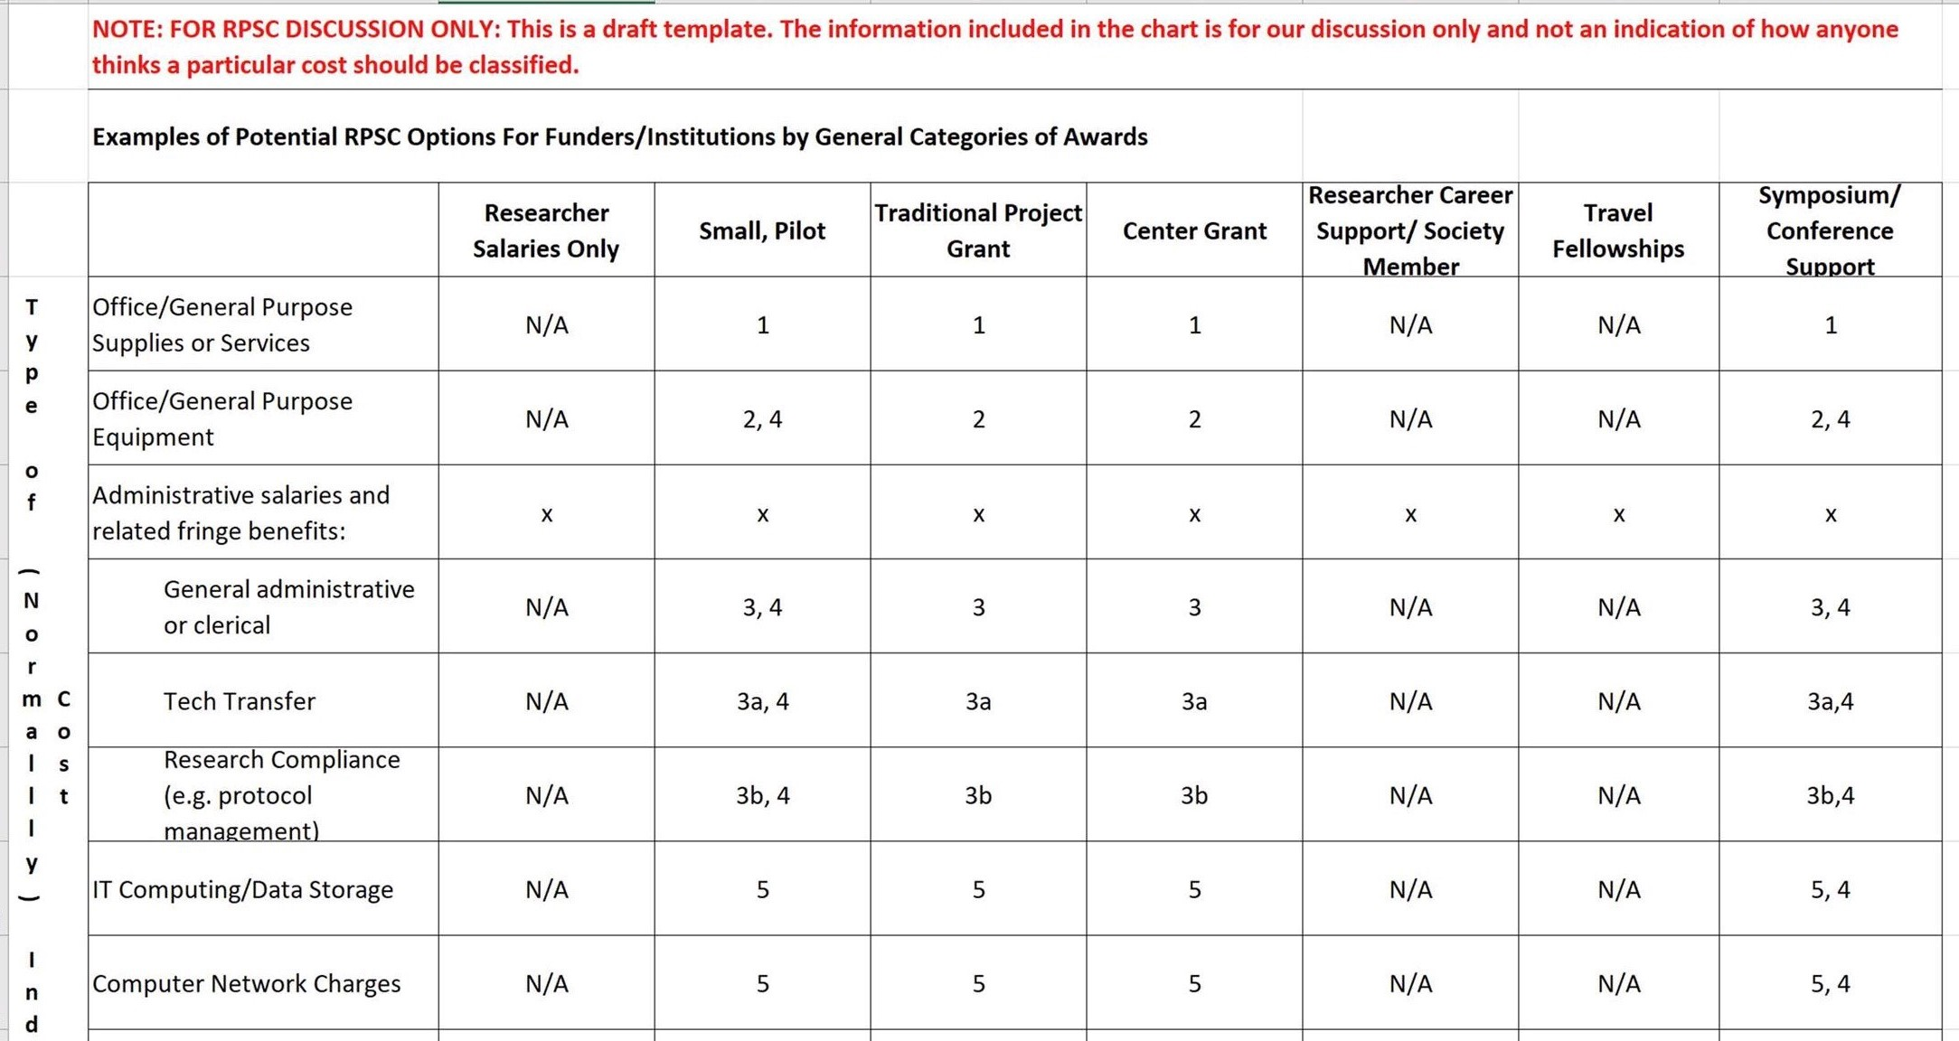
Research Project Support Costs

Slide 25
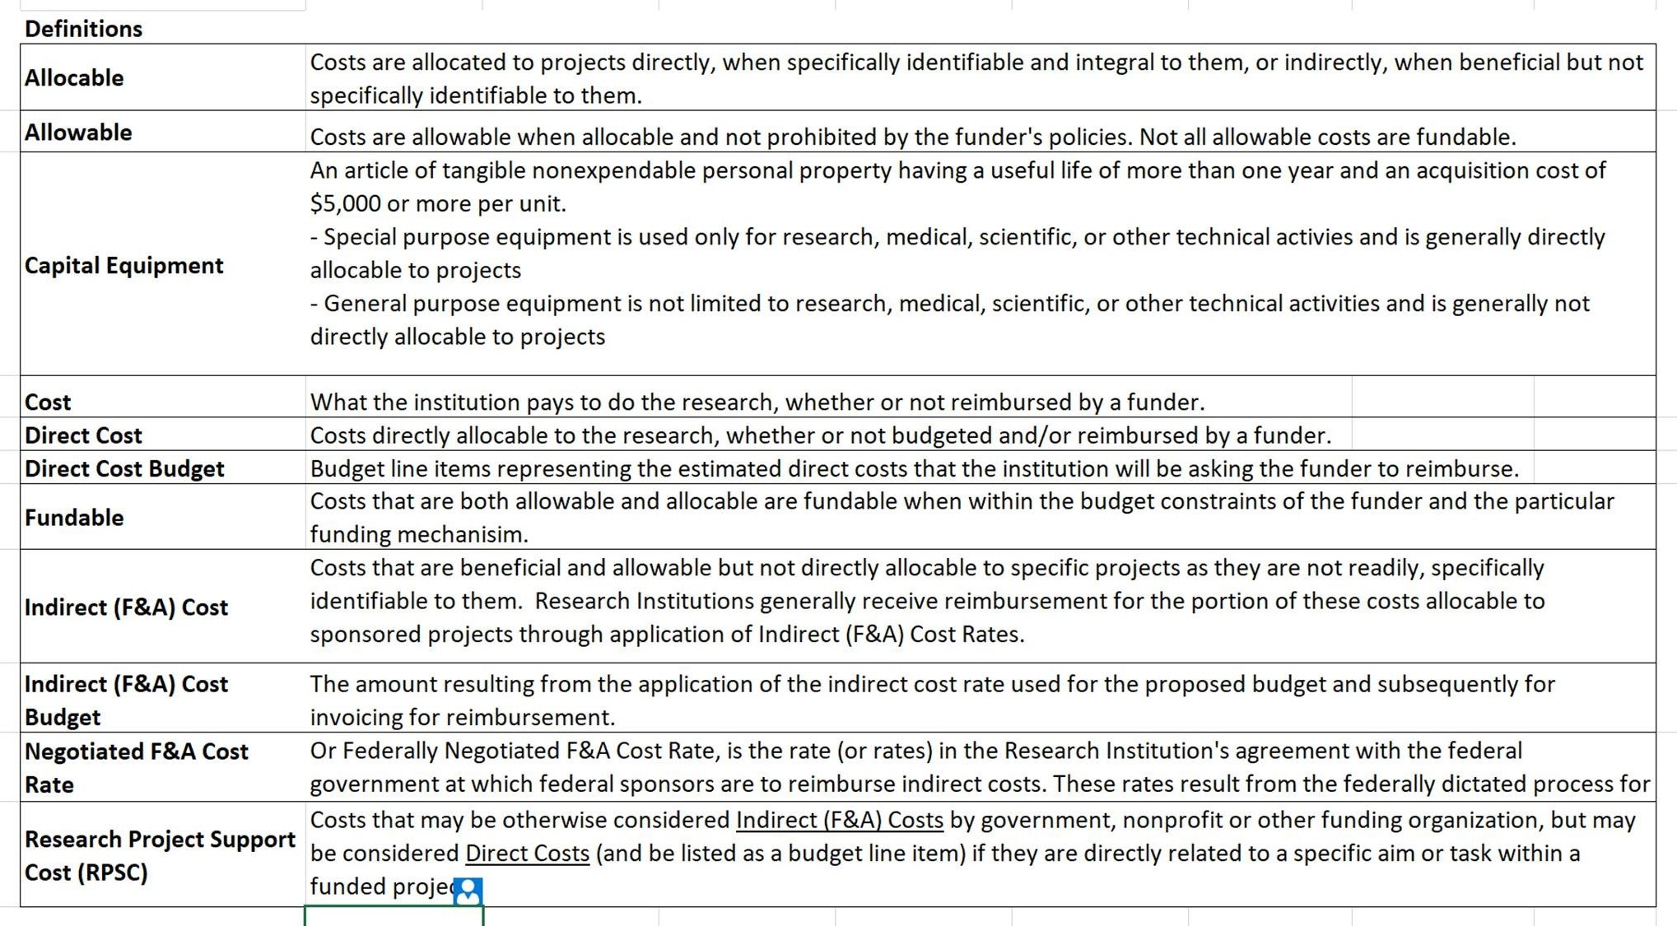
Research Project Support Costs

Slide 26
Today’s Breakout Session
Potential uses for examples and definitions
Funder FAQs for Research Institutions
Is there another approach to explore?

Slide 27
Subgroup Members
Diane Bovenkamp, BrightFocus Foundation
Maryrose Franko, Health Research Alliance
Cindy Hope, University of Alabama
David Kennedy, COGR
Jim Luther, Duke University
Heather Snyder, Alzheimer's Association
Please join us!

Slide 28
Working Groups and Subgroups
  Intellectual Property and Technology Transfer
    Royalty Sharing
    Control of Licensing
    IP Definitional
    Patient Access
  Research Project Support Costs
    Education
    Support Costs
  Streamlining Administrative Requirements
    Application Processes
    Contracting
    Financial Reporting

Slide 29
NFRI Partnership: Streamlining Administrative Requirements
“Streamlining Foundation Requirements and Processes To Reduce Administrative Burden and Cost” COGR, September 2017
Working Group Leads:
Andrew Smith, Susan G. Komen for the Cure
Vivian Holmes, Boston University

Slide 30
NFRI Streamlining Workgroup
November 2018 Session Topics
Proposal Submission
Communication
Award Issuance and Acceptance
Financial and Progress Reporting
Terminology

Slide 31
NFRI Streamlining Workgroup
Recommendations/Suggestions
Areas of Agreement: communication, consistency
Near-term Deliverables: contact info, delegated authority
Longer-term Deliverables: all policies/procedures on NFRI site
Areas for further discussion: access to clearinghouse info

Slide 32
NFRI Streamlining Workgroup
November 2018 Breakout Session
Common challenges and goals – Subgroup Leaders
Application Process:
Marti Dunne, NYU; Calvin Ho, TSA
Financial Reporting:
Charles Greer, UC Riverside; Mehvish Khan, Conquer Cancer
Policies, Terms and Conditions:
Missy Peluso, Upenn; Whitney Steen, Lymphoma Research Foundation

Slide 33
Streamlining Administrative Requirements - Working Group on Streamlining Application Processes
Working Group Goals: Identify ways of reducing burden for both higher education institutions and nonprofit funders in the application process
Chair for subgroup for research institutions:
Marti Dunne, New York University
Chair for nonprofit funders:
(formerly) Calvin Ho, Tuberous Sclerosis Alliance

Slide 34
Members
Susan Fargo | American Epilepsy Society
Andrew Murtishaw | Alzheimer's Association
Erik Lontok | Lipedema Foundation
Stacy Cloud | Donaghue Foundation
Dario Dieguez | Foundation for Physical Therapy
Vidya Browder | Children's Tumor Foundation
Kristen Mueller | Melanoma Research Alliance
Marti Dunne | NYU
Surya K. Mallapragada | Iowa State University
Marcia Landen | University of Southern Mississippi
Stephanie Endy | Case Western Reserve University
Nancy Daneau | NYU
Sheila Lischwe | Clemson
David Ross | Notre Dame
Laura Fuentes | Johns Hopkins
Maggie Cho | UCSF
Cathy Cuppett | University of Georgia
Anna Jackson | University of Chicago
Esther Pratt | Washington State University
Jeanne Wicks | University of Nebraska, Lincoln
Lisa Nichols | Council on Government Relations

Slide 35
Current Initiatives
Expanding the FDP Clearinghouse:
  Expand the data available in the Federal Demonstration Partnership (FDP) Clearinghouse to include information of interest to nonprofit funders.
    Encourage funders to use the institutional profiles in the Clearinghouse, eliminating the need for requests to obtain entity-based information. Every participating research institution has a single profile in the database and is committed to keeping the information up-to-date. The working group will explore which additional data fields should be proposed to the FDP. The database is open to anyone seeking profile information. https://fdpclearinghouse.org/

Slide 36
Collaboration with grants management system providers
Altum, the developer of proposalCENTRAL (the application submission system used by many nonprofit funders), has offered to make changes that would streamline proposal submissions for both institutions and funders. The working group will explore what changes users would like to see to the system.
Altum has also just developed an institutional portal so that submissions may be tracked by IHEs and progress and final reports monitored.

Slide 37
Just-in-Time
Borrowing from streamlining efforts by the Federal government, we are asking both funders and institutions to suggest areas which may be conducive to Just-in-Time submission.
  Human and animal subjects reviews are two obvious areas which could save effort on both sides.
  Suggestions for other areas are now being sought.

Slide 38
Other Issues
Standardizing:
  Eligibility criteria
    Who may submit
    How many applications may an institution submit
  Application guidelines
    Average award for the competition
    Annual Deadlines (dates and how many per year)
    Just-in-time information (?)
  Applications
    Cover page
    Biosketch
    Others?

Slide 39
NFRI Contracting Subgroup
Leads: Whitney Steen (Lymphoma Research Foundation), Missy Peloso (University of Pennsylvania)
Members: Elizabeth Adams (Princeton), Alexandra Albinak (Johns Hopkins), Jackie Bendall (COGR), Tamara Croland (JDRF), Ruchika Dhussa (California), Lynne Elmore (American Cancer Society), Jackie Hausman (KR Foundation), Felice Lu (California), Barbara Malm (Foundation for Physical Therapy), Nate Martinez-Wayman (Duke), Lisa Nichols (COGR), Phillip Rena (Cold Spring Harbor), Toni Russo (COGR)

Slide 40
Contracting Subgroup Initiatives
Develop sample contract language that is generally acceptable to both institutions and funders (primarily compliance as initial focus)
Create whitepaper explaining the rationale for both funder and university positions on contracting issues

Slide 41
Contracting Subgroup
Current Activities
Catalog of contract language in current non-profit funder agreements
Draft of mutually agreeable sample contract language for select areas:
General compliance language
Responsibility/
Indemnification
Export Compliance/
Anti-terrorism
Research Misconduct
Conflict of Interest
Use of Animal/Human Subjects (incl. Clinical Trials)
Data Sharing
Public Access
Use of Name

Slide 42

Financial Reporting Subgroup
Survey Results

Slide 43
Responding Organizations
23 Institution Responses
15 Funder Responses
As of 5/15/19

Slide 44
Where Funders Want Costs Budgeted & Reported

Slide 45
Pre-Award/Proposal Phase Budget

Slide 46
Post-Award Actuals & Accounting

Slide 47
Observations
Overall Institution pre/post-award budgets and expenses were fairly similar
Institutions allocate based on the terms in the notice of award or specific circumstances
Funders and Institutions create specific line items/budget categories when expenses don’t fall into pre-determined classifications
Specific Category Discussions

Slide 48
Discussion Topics
IRB Fees
Participant Remuneration
Student Stipends
Catering/AV
Rent
Supplies

Slide 49
IRB
Both:
  Specific line items/categories
  ‘Other Costs’ or ‘Other Direct Costs’
Funders:
  Categorized as ‘Research’ (non-grants), or as a programmatic expense
  Has never been raised as a cost
  ‘IDC’
Institutions:
  Non-federal sponsored trials are under ‘Other costs’

Slide 50
Participant Remuneration
Both: Specific line items/categories
Funders:
  ‘Other costs’ or ‘Other Direct Costs’
Institutions:
  ‘Services’ or ‘Other Non-Payroll’
  Listed as participant fees
  ‘Other Direct Costs’ and subject to F&A
  Separate cost categories and don’t charge F&A
  ‘Federal participant’ cost category is specific, but research participant payments are under ‘Other costs’

Slide 51
Student Stipends
Funders:
  Custom or ‘Other direct costs’
  Provide fellowships to cover trainee (postdoc, fellow, or predoc) stipends; willing to have those funds used for benefits as well, but such information and the process confirming those levels seem to vary widely
Institutions
  ‘Services’ or ‘Other’
  Student stipends would be in ‘Personnel’ for research projects
  Student stipends/participant remuneration for conference/ workshop/training projects would be ‘Participant support’

Slide 52
Catering/AV Costs
Both:
  Specific line items/categories
Institutions:
  Typically unallowable unless specific to the RFA or program plan, otherwise they're treated as F&A
  Allowable only when hosting conferences, are normally in the ‘Other costs’ category
  Conference fees may be ‘Travel’ or ‘Services’ depending on how they’re indicated in the FOA

Slide 53
Rent
Both:
  Specific line items/categories
Funders:
  Something we haven’t seen before
  ‘Other costs’ or ‘Other Direct Costs’
Institutions:
  Listed as rental charge or fee for space used for events
  Non-Payroll Rent: ‘IDC’ if an on-campus award
  ‘Services’ or ‘Other Non-Payroll’ if off-campus

Slide 54
Supplies
Funders:
  Generally either ‘Supplies’ or ‘IDC’
Institutions:
  Allocate based on the terms in the notice of award or specific circumstances

Slide 55
Questions or Comments?

Slide 56
ADDITIONAL SURVEY RESPONSES

Slide 57
“Other”Funder Comments
Specific line categories (e.g., Catering: meeting; Participant remuneration: subject costs; Student stipends: student stipends).
Stipends – custom or ‘Other direct costs’
  Provide fellowships to cover trainee (postdoc, fellow, or predoc) stipends; willing to have those funds used for benefits as well but such information and the process confirming those levels seem to vary widely
Indirect – Don't pay indirect on fellowship grant; would have a custom category, such as clinical research expenses, for IRB fees and participant remuneration.
Conference and registration fees may also be charged to travel depending upon the awardee institution’s GL coding.
IRB, Participant Remuneration, and Rent – ‘Other costs or ‘Other Direct Costs’
  IRB fees are categorized as Research (non-grants), as a programmatic expense, or have never been raised as a cost
  Rent is something we haven’t seen before
  Participant remuneration: have patient cost category, if that's not an option then 'other’; would ideally be study costs or supplies
Laptop computer and printers – small equipment; might be equipment if highly specialized resources that are above standard pricing;
  If required to conduct research, equipment; if for general use, indirect costs

Slide 58
“Other”Pre-Award Institution Comments
Allocate based on the terms in the notice of award or separate/specific categories or line items
Catering/AV & Conference costs:
  Typically unallowable unless specific to the RFA or program plan, otherwise they're treated as F&A
  Allowable only when hosting conferences, are normally in the Other costs category. Conference fees may be travel or Services depending on how they are indicated in the FOA
Participant Renumeration
  Services or Other Non-Payroll;
  Listed as participant fees
  Other Direct Costs and subject to F&A
  Separate cost categories and don’t charge F&A
  Federal participant cost category is specific, but research participant payments are under other costs
  Student Stipends – Services or Other Student stipends would be in personnel for research projects
  Student stipends/participant remuneration would be "participant support" for conference/workshop/training projects
Laptops, etc. - generally IDC but if well justified can be charged as supplies
IRB fees for non-federal sponsored trials are under other costs category
Rent – Listed as rental charge or fee for space used for events; Non-Payroll Rent – IDC if an on-campus award, Services or Other Non-Payroll if off campus

Slide 59
“Other”Post-Award Institution Comments
Allocate based on the terms in the notice of award or specific circumstances
Our proposal budgets align with our post-award GL
Have specific general ledger account codes for catering, conference registration fees, fees, participant remuneration (depending what the expense is), stipends, and rent
During post award set up, establish a separate sub fund for the participant support costs and utilizes a separate budget class for rent expenditures; costs post in applicable categories – stipend, supplies, travel, etc.
Other Costs or Other Direct Costs –
  Including IRB fees and participant remuneration
  Student stipends would be treated as stipends through the Financial Aid Office and listed under "other expenses" in financial system

Slide 60
Primary Payment Term by Type
Funders – which types of awards you issue
  Highest rank: Firm-fixed-price/milestone-based payments
  Lowest rank: Other or Cost-reimbursable
Institutions – which types of awards you receive
  Highest rank: Cost-reimbursable
  Lowest rank: Other

Slide 61
Invoice Receipt
Funders primarily receive invoices via an online grants management system (n=6) or by e-mail (n=4).
  7 funders responded that they do not require an invoice, either because they issue firm-fixed-price awards or that invoices are not required.
Institutions primarily submit invoices via email (selected by all respondants), as well as online via an online grants management system or snail mail.
  2 institutions send via FedEx for international recipients.

Slide 62
Preferred standard payment terms upon receipt of an invoice

Slide 63
Financial Compliance Audits

Slide 64
Time of Financial Closeout Once the Award Ends

