Slide 1
Health Research Alliance
March 9, 2022

Slide 2

Disability Impacts All of Us
ADA Definition
A physical or mental impairment that substantially limits one or more major life activities

Slide 3
Examples
Disability may be life-long or acquired,
apparent or non-apparent.
Examples:
  Physical and mobility (polio, limb difference)
  Sensory (Deaf/hard of hearing, blind/low vision)
  Intellectual and Developmental (IDD) (Down’s Syndrome, Autism, CP)
  Psychosocial/Mental Health (depression, bi-polar, ADHD)
  Learning (dyslexia, auditory processing disorder)
  Chronic illness (cancer, HIV, Crohn’s, Diabetes)

Slide 4

What is disability?

Slide 5
Disability Inclusion Rights, And Justice
Nothing About Us Without Us
Disability Rights
  Civil Rights movement culminating in the ADA (1990)
Disability Justice
  Centers queer and transgender disabled people of color
Disability Inclusion
  Umbrella term, centering disabled people

Slide 6
Why Ask: Disability is Part of Diversity
Explain how information will be used
Define disability with examples
Update regularly

Slide 7
How to Ask
Sample questions:
  https://disabilityphilanthropy.org/resource/increasing-disability-inclusion-by-tracking-participation/
ADA focused
  Conditions
Functionally focused
  Activities/accommodations
Language considerations

Slide 8
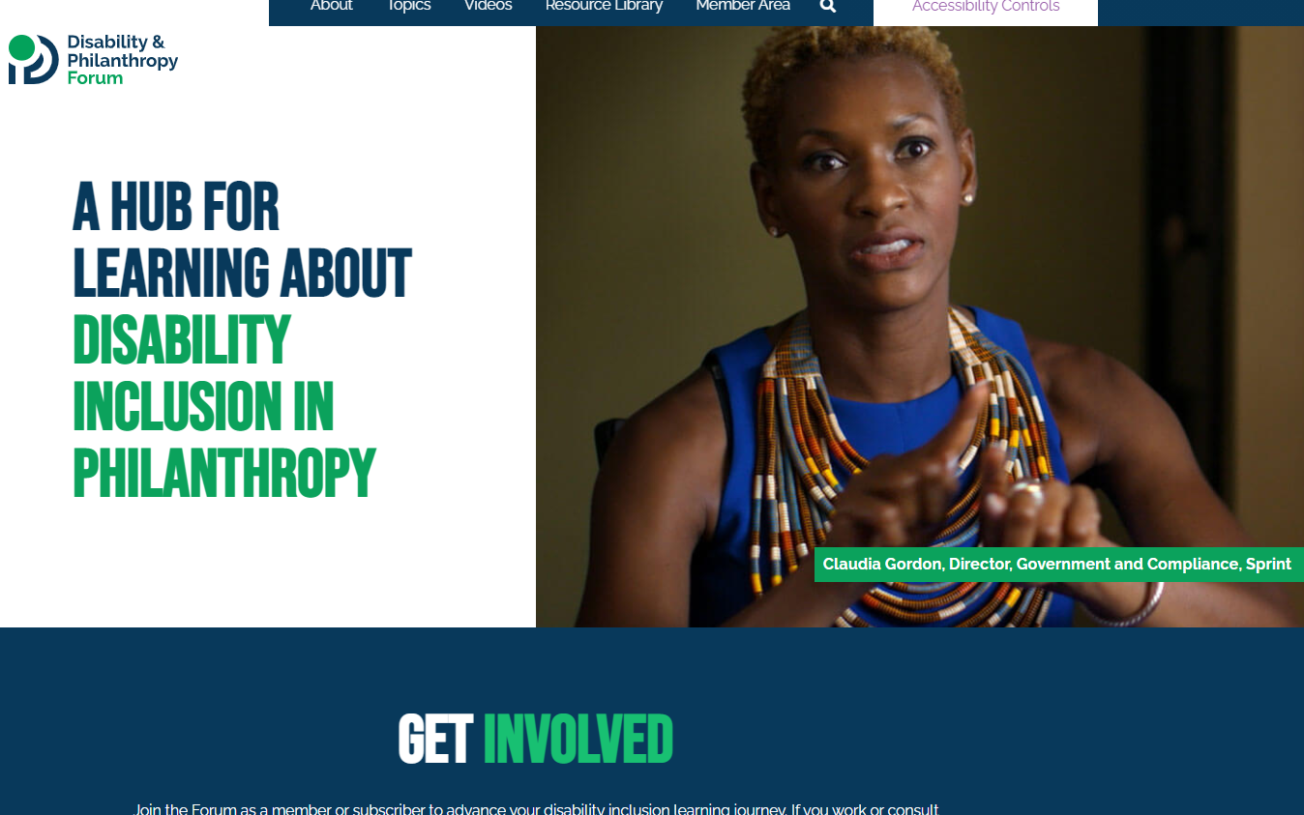
Disability and Philanthropy Forum

Slide 9

Living our Values: the Disability Inclusion Pledge
Disability community engagement
Disability-inclusive language
Accessible Events
Inclusion Audits and Plans
Staff Training and Participation
Board Training and Participation
Disability Grantmaking
Measure and Report

Slide 10

Join Us
https://disabilityphilanthropy.org/
emily.harris@disabilityphilanthropy.org

